Slide 1
Leukemia Detection using Microscopic Blood Sample Images
Name: Nischal Badal
Roll No: 631

Slide 2
Introduction
Leukemia refers to the cancer that involves malfunction of blood-forming tissues of the bone marrow.
When a person has leukemia, the bone marrow does not work properly.
Moreover, these abnormal leukemia cells generally spread into the blood rapidly and can also invade other body parts like spleen, liver, kidney, lymph nodes, and brain, which may lead to other forms of cancer.

Slide 3
Background
The diagnosis of leukemia frequently follows a routine blood test that results in an abnormal blood cell count.
The existing methods of diagnosis of leukemia include:
Complete blood count (CBC),
Bone marrow aspiration,
Cytogenetic analysis (chromosomes identification) and
Immunohistochemistry (blood samples are treated with special antibodies and color change is observed).

Slide 4
Project Objective
To overcome the related constraints in visual inspection of Leukemia.
To ease the detection process with less error rate i.e. neutralizing human errors.
To learn different Image Processing techniques as Image Enhancement, Thresholding, Mathematical morphology, labeling, etc.

Slide 5
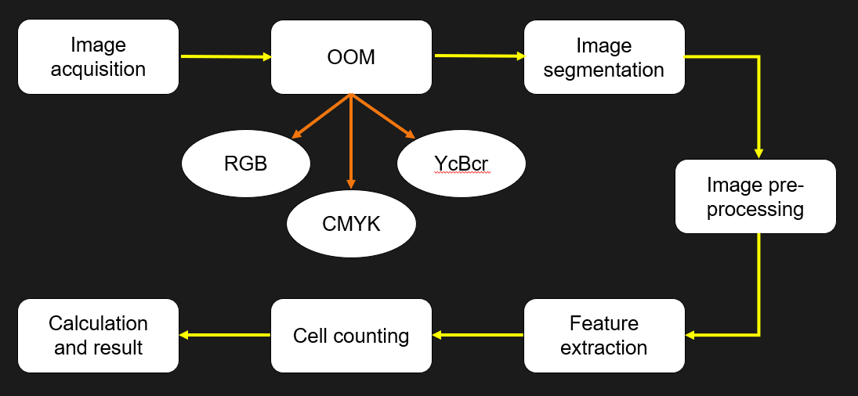
Methodology

Slide 6
Methodology
Image Acquisition I
In the form of Microscopic sample of Blood.
Conversion of RGB images into greyscale image
Histogram equalization
To contrast the image.
Image Segmentation
Segmentation of White Blood Cells

Slide 7
Methodology
Feature Extraction
Add bounding box to the segmented white blood cells
Cell Counting
Count the total number of white blood cells
Calculate the percentage of WBCs and RBCs, determine if potential Leukemia detected
A person is affected to leukemia if the percentage of WBC is higher than 20%.

Slide 8
Expected Result
The MATLAB GUI will open to input a microscopic image of blood sample.
It undergoes above mentioned steps and displays output image in every step along with algorithm used.
The final feature extraction process will determine weather there is occurrence of Leukemia or not with the error percentage.

Slide 9
Project Phase
The image processing techniques are applied to obtain images after each processing technique.
For the GUI, coding is in process that includes MATLAB for a minimalistic interface.
The related data sets for different types of Leukemia is analyzed which was obtained from different sources as Anno-DB and Kaggle.

Slide 10
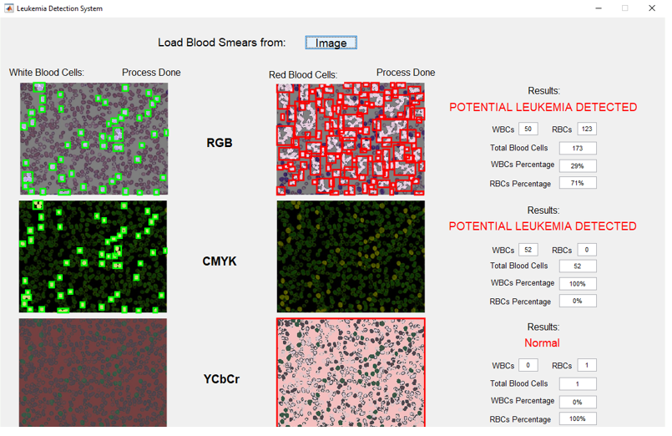
GUI

Slide 11
Queries
Thank You

